Slide 1
Chapter 3.3
<course>
<Chapter>
Semantic Web
</Chapter>
<lecturer>Guibing Guo</lecturer>
</course >

Slide 2
Question
How do you understand this world?
This world is built on __ and __?
Notes:
I understand this world by Knowledge (=facts + rules)? From Wikipedia: Knowledge is a familiarity, awareness, or understanding of someone or something, such as facts, information, descriptions, or skills, which is acquired through experience or education by perceiving, discovering, or learning.

Slide 3
Essential Concepts
Data Model (Knowledge)
Facts (data representation)
Rules (logic in data)
Explain/Validate facts
Infer implicit knowledge
Example
Dr. Guo supervised me for years
Only professors can supervise students
Notes:
Facts: a.k.a. assertional knowledge, regarding individual objects
Rules: a.k.a. terminological knowledge, more generic knowledge

Slide 4
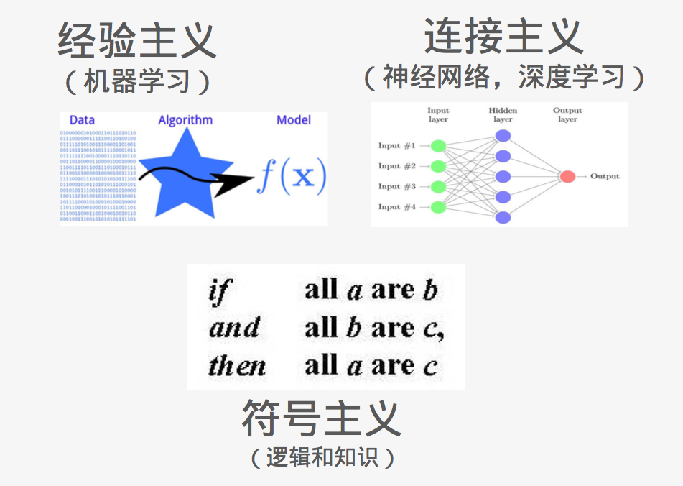
Artificial Intelligence
This slide is from https://zhuanlan.zhihu.com/p/26208385?group_id=833348558605406208
Notes:
人工智能现在有很多不同的分支，我这里列了三个主要的分支，就是经验主义(empiricism)，或者称为机器学习方法，还有联结主义(connectionism)，最近最火就是深度学习，在这之前是神经网络方法，还有今天我们要谈到的知识的方法，就是符号主义(Symbolicism)，更早的时候叫逻辑，后来在90年代末的时候，开始有一个领域叫语义网，后来演化成了知识图谱。在金融领域里面，早期大家对于机器学习比较熟悉，包括像信用卡导购，营销，用户画像技术，我们都会用到很多机器学习的方法；最近一两年时间，深度学习开始广泛的应用，知识图谱进入还是算比较晚的吧。

Slide 5
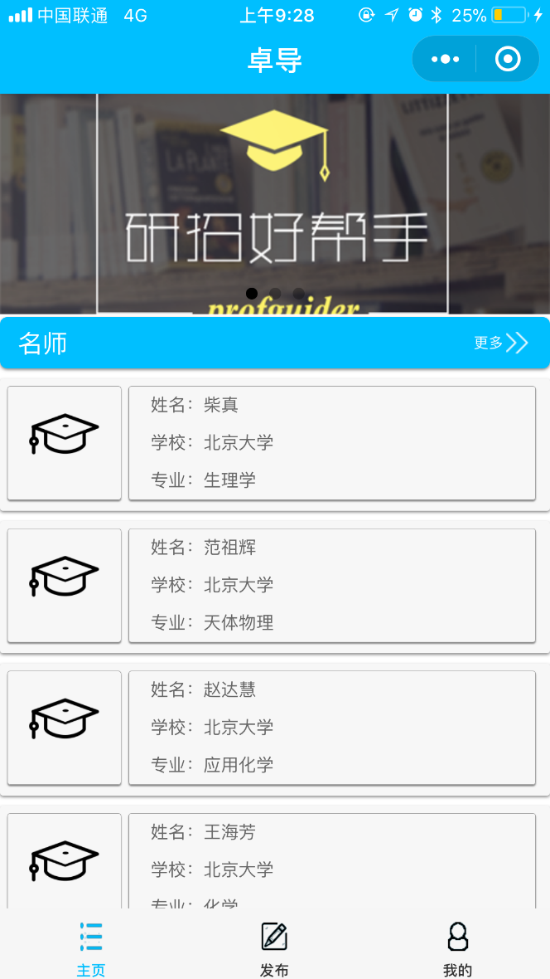
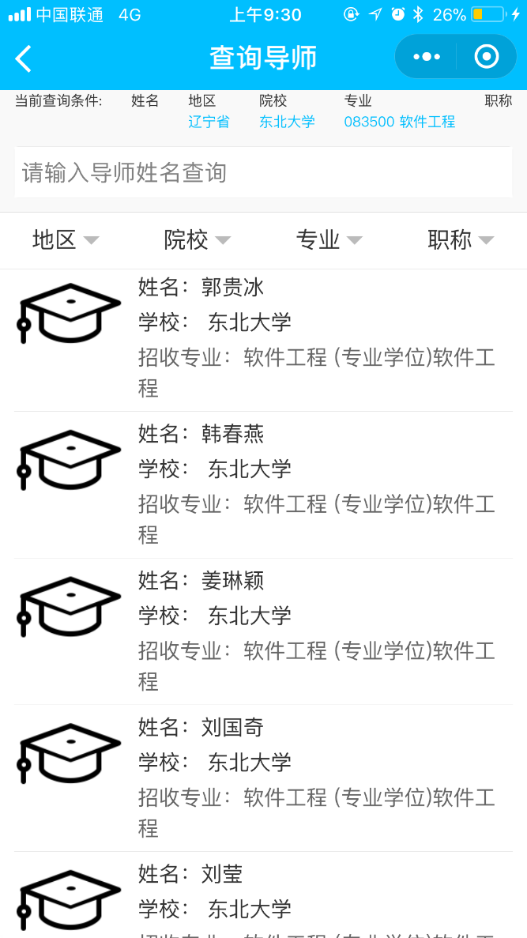
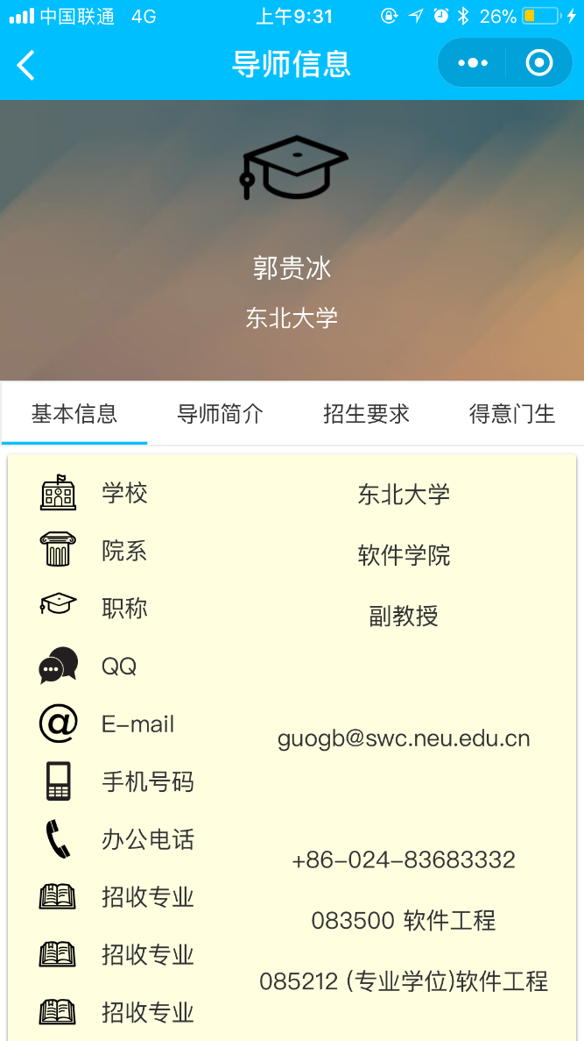
Study Case
卓导
Notes:
江西财经大学(Jiangxi University of Finance and Economics)
Q: 如何得到各个高校的导师信息？
Q: 还缺少哪些关于导师的重要信息？Publications. Reputation. Social Connections.
Q: 如何根据学生的需求推展导师？要求：必须要求好导师，对学生的影响巨大；必须要求好学生，能与老师相配合。案例：武汉理工学生跳楼
Paper: RecAdvisor: Criteria-based Ph.D. Supervisor Recommendation by Mir Anamul Hasan (Florida State University); Daniel G. Schwartz (Florida State University)

Slide 6
A Motivation Example
What are semantic web concepts?
What are the benefits of representing our data with the semantic web concepts and technologies?

Slide 7

We start with a book …

Slide 8

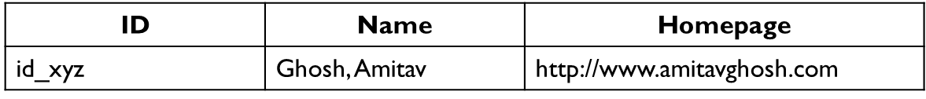
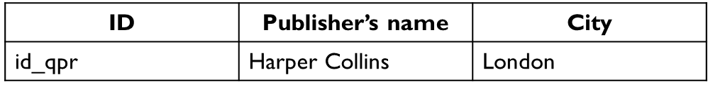
Bookstore database
Book
Author
Publisher

Slide 9
Graph Representation
a:title
The Glass Palace
http://…isbn/000651409X
2000
a:year
a:publisher
London
a:city
a:author
Harper Collins
a:p_name
a:name
a:homepage
Ghosh, Amitav
http://www.amitavghosh.com

Slide 10

Same book in French …

Slide 11
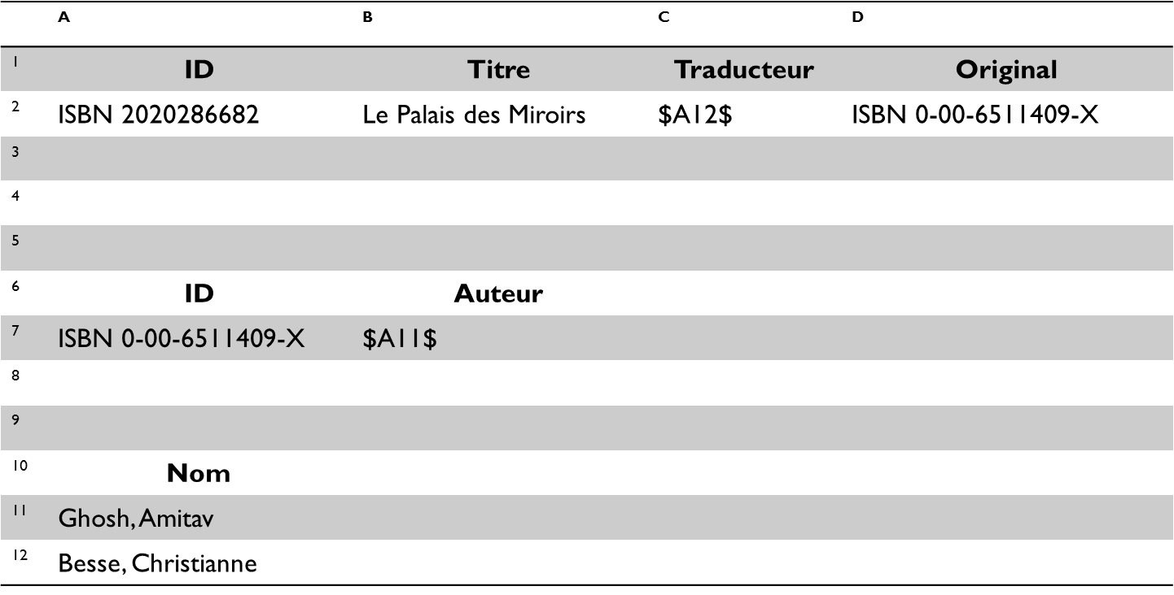
Bookstore database
Traducteur: 译者

Slide 12
Graph Representation
http://…isbn/000651409X
Le palais des miroirs
f:original
f:titre
f:auteur
http://…isbn/2020386682
f:traducteur
f:nom
f:nom
Ghosh, Amitav
Besse, Christianne

Slide 13


Data Merging
The Glass Palace
a:title
http://…isbn/000651409X
2000
a:year
a:publisher
Same URI!
London
a:city
Harper Collins
a:p_name
a:author
a:name
http://…isbn/000651409X
a:homepage
f:original
Le palais des miroirs
Ghosh, Amitav
http://www.amitavghosh.com
f:auteur
f:titre
http://…isbn/2020386682
f:traducteur
f:nom
Ghosh, Amitav
f:nom
Besse, Christianne
Notes:
为什么要做融合：
不想玩单机游戏，联网才好玩；
增强现有的图书管理系统：一本图书多个语言版本；获得对图书的更完整认识；
构建大数据系统：如 Smart City，创造新价值；

Slide 14
Data Merging (2)
The Glass Palace
a:title
http://…isbn/000651409X
2000
a:year
a:city
a:publisher
London
Harper Collins
a:p_name
a:author
f:original
a:name
f:auteur
a:homepage
Le palais des miroirs
Ghosh, Amitav
http://www.amitavghosh.com
f:titre
http://…isbn/2020386682
f:traducteur
f:nom
Ghosh, Amitav
f:nom
Besse, Christianne

Slide 15
Start making queries
Now French users can make queries about the title of the original book
Cannot locate in French database
… but can be retrieved by merging both databases

Slide 16
And more can be done …
a:author == f:auteur
But an automatic merging doesn’t know
Extra knowledge required
a:author & f:author → Person
Person is defined as:
Full name, homepage, email, address
Can be used as a “category” for resources

Slide 17
Data Merging (3)
The Glass Palace
a:title
http://…isbn/000651409X
2000
a:year
Le palais des miroirs
a:publisher
f:original
London
a:city
f:titre
Harper Collins
a:p_name
a:author
http://…isbn/2020386682
r:type
f:traducteur
a:name
r:type
a:homepage
http://…foaf/Person
f:nom
Ghosh, Amitav
Besse, Christianne
http://www.amitavghosh.com

Slide 18
Enables richer queries …
French users can now ask the homepage of the original author
But …
What if French users want to know other books written by the original author
Or more information about the author?

Slide 19
Keep Merging with other databases
DBpedia (from "DB" for "database") is a project aiming to extract structured content from the information created in the Wikipedia project. This structured information is made available on the World Wide Web.
DBpedia allows users to semantically query relationships and properties of Wikipedia resources, including links to other related datasets.
Notes:
Dbpedia is actually an applications of semantic Web.

Slide 20
Merge with Wikipedia data
The Glass Palace
a:title
http://…isbn/000651409X
2000
a:year
f:original
Le palais des miroirs
a:publisher
f:titre
London
a:city
Harper Collins
a:p_name
a:author
http://…isbn/2020386682
f:auteur
r:type
f:traducteur
a:name
http://…foaf/Person
r:type
f:nom
a:homepage
r:type
f:nom
Besse, Christianne
Ghosh, Amitav
http://www.amitavghosh.com
foaf:name
w:reference
http://dbpedia.org/../Amitav_Ghosh

Slide 21
Merge with Wikipedia data (2)
The Glass Palace
a:title
http://…isbn/000651409X
2000
a:year
f:original
Le palais des miroirs
a:publisher
f:titre
London
a:city
Harper Collins
a:p_name
a:author
f:auteur
http://…isbn/2020386682
r:type
f:traducteur
a:name
a:homepage
http://…foaf/Person
r:type
f:nom
f:nom
r:type
w:isbn
Besse, Christianne
Ghosh, Amitav
http://www.amitavghosh.com
foaf:name
w:reference
http://dbpedia.org/../The_Glass_Palace
w:author_of
http://dbpedia.org/../Amitav_Ghosh
w:author_of
http://dbpedia.org/../The_Hungry_Tide
w:author_of
http://dbpedia.org/../The_Calcutta_Chromosome

Slide 22
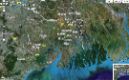
Merge with Wikipedia data (3)
The Glass Palace
a:title
http://…isbn/000651409X
2000
a:year
f:original
Le palais des miroirs
a:publisher
f:titre
London
a:city
Harper Collins
a:p_name
a:author
f:auteur
http://…isbn/2020386682
r:type
f:traducteur
a:name
http://…foaf/Person
r:type
f:nom
a:homepage
r:type
f:nom
w:isbn
Besse, Christianne
Ghosh, Amitav
http://www.amitavghosh.com
foaf:name
w:reference
http://dbpedia.org/../The_Glass_Palace
w:author_of
http://dbpedia.org/../Amitav_Ghosh
w:born_in
w:author_of
http://dbpedia.org/../Kolkata
http://dbpedia.org/../The_Hungry_Tide
w:author_of
w:long
w:lat
http://dbpedia.org/../The_Calcutta_Chromosome

Slide 23
Furthermore …
More extra knowledge to the merged datasets
Geographical information, etc.
Ontologies/rules to integrate more information
More powerful queries expected

Slide 24
A Cure to your lazy
Semantic Web
It provides technologies to make such integration possible!!!
Key applications, e.g., DBpedia have emerged
Say Bravo!!!

Slide 25
Examples in our daily life …
Sometimes we’d like to have much information cross different domains to help us make more informative decisions such as purchasing, befriending, etc.

Slide 26
B2C Electronic Commerce
Typical Scenario:
Users visit one or several online shops, browses their offers, purchases products
Balance between time and money
Solution: Shopbots
Notes:
Shopbot: 购物机器 人

Slide 27
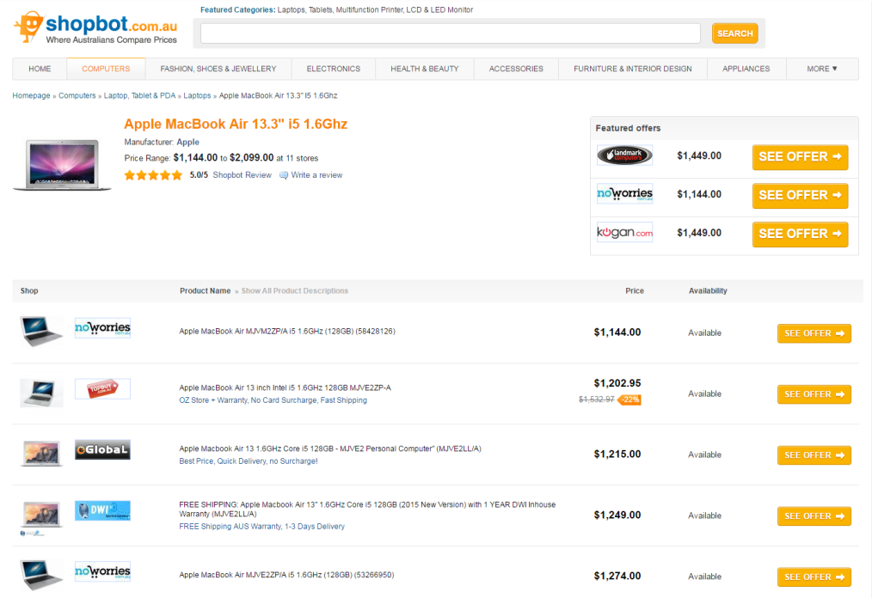
Shopbot.com.au

Slide 28
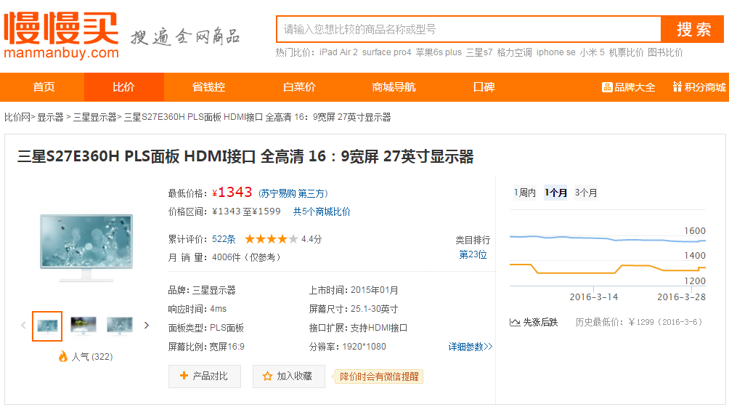
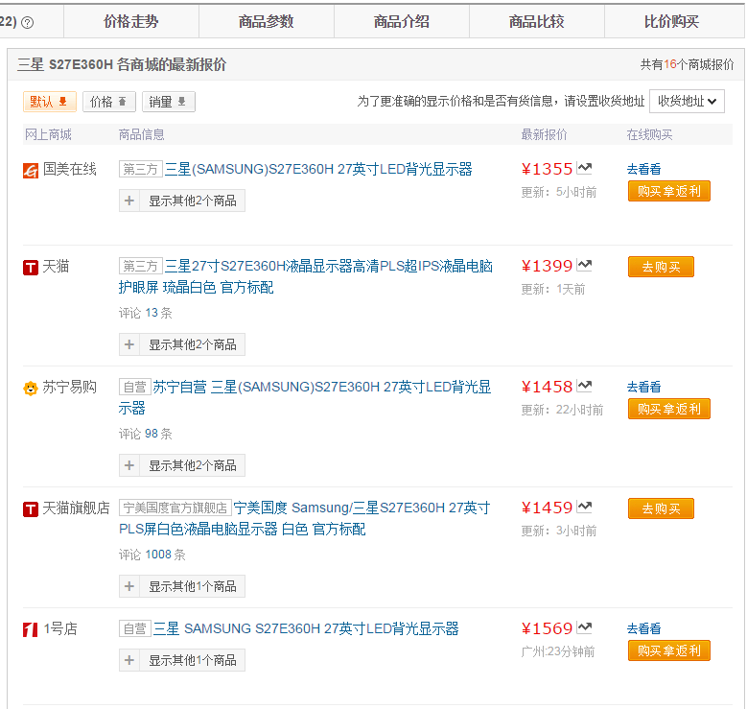
Manmanbuy.com

Slide 29
Limitations of Shopbots
Rely on wrappers
Extensive programming required
Need to be updated if stores change
Extract information from text
Error-prone
Limited information extracted

Slide 30
Software Agents
Interpret the product information and the terms of service
Pricing, delivery, privacy policies, etc.
Seller’s reputation
Automated negotiations
Personal agents

Slide 31
Lecture Outline
A Motivation Example
Semantic Web Technologies
A Layered Approach

Slide 32
Semantic Web Technologies
Explicit Metadata
Ontologies
Logics & Inference
Agents

Slide 33
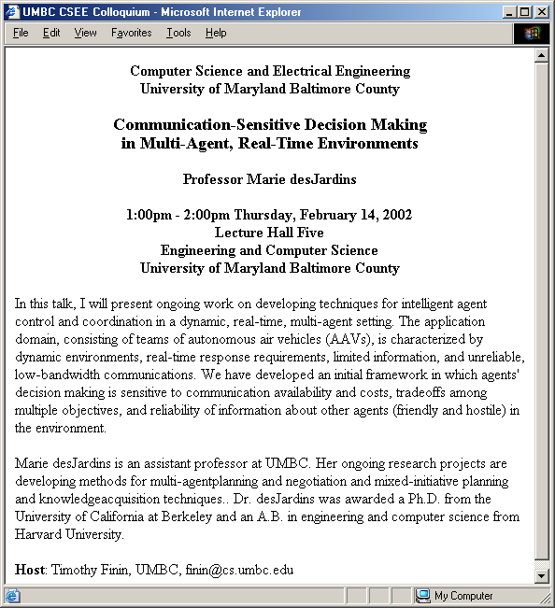
When we read a web page ...

Slide 34
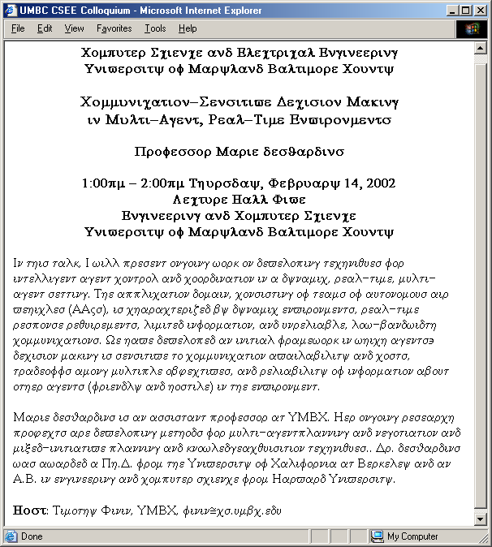
When machines read …

Slide 35
On HTML
Web content formatted for human readers rather than machines
HTML is the predominant language in which web pages are written

Slide 36
Description with tags
title
speaker
time
location
abstract
biosketch
host

Slide 37
Explicit Metadata
Metadata: data about data
Metadata capture parts of the meaning of the data
Semantic Web does not rely on text-based manipulation, but rather on machine-processable metadata

Slide 38
XML to rescue … ?
<title>
</title>
<speaker>
</speaker>
<time>
</time>
<location>
</location>
<abstract>
</abstract>
<biosketch>
</biosketch>
<host>
</host>

Slide 39
Too young too simple
But, to your machine, the tags still look like this….
The tag names carry no meaning.
XML DTDs and
Schemas have little or no semantics.
<τιτλε>
</τιτλε>
<σπεακερ>
</σπεακερ>
<τιμε>
</τιμε>
<λοχατιον>
</λοχατιον>
<αβστραχτ>
</αβστραχτ>
<βιοσκετχη>
</βιοσκετχη>
<ηοστ>
</ηοστ>

Slide 40
XML Schema helps
<?xml version="1.0" encoding="utf-8"?>
<xs:schema xmlns:xs="http://www.w3.org/2001/XMLSchema">
<xs:element name="book">
<xs:complexType>
<xs:sequence>
<xs:element name="title" type="xs:string"/>
<xs:element name="author" type="xs:string"/>
<xs:element name="character" minOccurs="0" maxOccurs="unbounded">
<xs:complexType>
<xs:sequence>
<xs:element name="name" type="xs:string"/>
<xs:element name="friend-of" type="xs:string" minOccurs="0"
maxOccurs="unbounded"/>
<xs:element name="since" type="xs:date"/>
<xs:element name="qualification" type="xs:string"/>
</xs:sequence>
</xs:complexType>
</xs:element>
</xs:sequence>
<xs:attribute name="isbn" type="xs:string"/>
</xs:complexType>
</xs:element>
</xs:schema>
XML Schemas provide a simple mechanism to define shared vocabularies.
XML Schema file
<τιτλε>
</τιτλε>
<τιτλε>
</τιτλε>
<σπεακερ>
</σπεακερ>
<σπεακερ>
</σπεακερ>
<τιμε>
</τιμε>
<τιμε>
</τιμε>
<λοχατιον>
<λοχατιον>
</λοχατιον>
</λοχατιον>
<αβστραχτ>
<αβστραχτ>
</αβστραχτ>
</αβστραχτ>
<βιοσκετχη>
<βιοσκετχη>
</βιοσκετχη>
</βιοσκετχη>
<ηοστ>
</ηοστ>
<ηοστ>
</ηοστ>

Slide 41
But there are many schemas
<?xml version="1.0" encoding="utf-8"?>
<xs:schema xmlns:xs="http://www.w3.org/2001/XMLSchema">
<xs:element name="book">
<xs:complexType>
<xs:sequence>
<xs:element name="title" type="xs:string"/>
<xs:element name="author" type="xs:string"/>
<xs:element name="character" minOccurs="0" maxOccurs="unbounded">
<xs:complexType>
<xs:sequence>
<xs:element name="name" type="xs:string"/>
<xs:element name="friend-of" type="xs:string" minOccurs="0"
maxOccurs="unbounded"/>
<xs:element name="since" type="xs:date"/>
<xs:element name="qualification" type="xs:string"/>
</xs:sequence>
</xs:complexType>
</xs:element>
</xs:sequence>
<xs:attribute name="isbn" type="xs:string"/>
</xs:complexType>
</xs:element>
</xs:schema>
<?xml version="1.0" encoding="utf-8"?>
<xs:schema xmlns:xs="http://www.w3.org/2001/XMLSchema">
<xs:element name="book">
<xs:complexType>
<xs:sequence>
<xs:element name="title" type="xs:string"/>
<xs:element name="author" type="xs:string"/>
<xs:element name="character" minOccurs="0" maxOccurs="unbounded">
<xs:complexType>
<xs:sequence>
<xs:element name="name" type="xs:string"/>
<xs:element name="friend-of" type="xs:string" minOccurs="0"
maxOccurs="unbounded"/>
<xs:element name="since" type="xs:date"/>
<xs:element name="qualification" type="xs:string"/>
</xs:sequence>
</xs:complexType>
</xs:element>
</xs:sequence>
<xs:attribute name="isbn" type="xs:string"/>
</xs:complexType>
</xs:element>
</xs:schema>
XML Schema file 1
XML Schema file 42
<τιτλε>
</τιτλε>
<title>
</title>
<σπεακερ>
</σπεακερ>
<speaker>
</speaker>
<τιμε>
</τιμε>
<time>
</time>
<λοχατιον>
<location>
</λοχατιον>
</location>
<αβστραχτ>
<abstract>
</αβστραχτ>
</abstract>
<βιοσκετχη>
<biosketch>
</βιοσκετχη>
</biosketch>
<ηοστ>
</ηοστ>
<host>
</host>

Slide 42
There’s no way to relate them
<?xml version="1.0" encoding="utf-8"?>
<xs:schema xmlns:xs="http://www.w3.org/2001/XMLSchema">
<xs:element name="book">
<xs:complexType>
<xs:sequence>
<xs:element name="title" type="xs:string"/>
<xs:element name="author" type="xs:string"/>
<xs:element name="character" minOccurs="0" maxOccurs="unbounded">
<xs:complexType>
<xs:sequence>
<xs:element name="name" type="xs:string"/>
<xs:element name="friend-of" type="xs:string" minOccurs="0"
maxOccurs="unbounded"/>
<xs:element name="since" type="xs:date"/>
<xs:element name="qualification" type="xs:string"/>
</xs:sequence>
</xs:complexType>
</xs:element>
</xs:sequence>
<xs:attribute name="isbn" type="xs:string"/>
</xs:complexType>
</xs:element>
</xs:schema>
<?xml version="1.0" encoding="utf-8"?>
<xs:schema xmlns:xs="http://www.w3.org/2001/XMLSchema">
<xs:element name="book">
<xs:complexType>
<xs:sequence>
<xs:element name="title" type="xs:string"/>
<xs:element name="author" type="xs:string"/>
<xs:element name="character" minOccurs="0" maxOccurs="unbounded">
<xs:complexType>
<xs:sequence>
<xs:element name="name" type="xs:string"/>
<xs:element name="friend-of" type="xs:string" minOccurs="0"
maxOccurs="unbounded"/>
<xs:element name="since" type="xs:date"/>
<xs:element name="qualification" type="xs:string"/>
</xs:sequence>
</xs:complexType>
</xs:element>
</xs:sequence>
<xs:attribute name="isbn" type="xs:string"/>
</xs:complexType>
</xs:element>
</xs:schema>
XML Schema file 1
XML Schema file 42
<τιτλε>
</τιτλε>
<title>
</title>
<σπεακερ>
</σπεακερ>
<speaker>
</speaker>
<τιμε>
</τιμε>
<time>
</time>
<λοχατιον>
<location>
</λοχατιον>
</location>
<αβστραχτ>
<abstract>
</αβστραχτ>
</abstract>
<βιοσκετχη>
<biosketch>
</βιοσκετχη>
</biosketch>
<ηοστ>
</ηοστ>
<host>
</host>

Slide 43
An ontology level is needed
XML Ontology 256
<?xml version="1.0" encoding="utf-8"?>
<xs:schema xmlns:xs="http://www.w3.org/2001/XMLSchema">
<xs:element name="book">
<xs:complexType>
<xs:sequence>
<xs:element name="title" type="xs:string"/>
<xs:element name="author" type="xs:string"/>
<xs:element name="character" minOccurs="0" maxOccurs="unbounded">
<xs:complexType>
<xs:sequence>
<xs:element name="name" type="xs:string"/>
<xs:element name="friend-of" type="xs:string" minOccurs="0"
maxOccurs="unbounded"/>
<xs:element name="since" type="xs:date"/>
<xs:element name="qualification" type="xs:string"/>
</xs:sequence>
</xs:complexType>
</xs:element>
</xs:sequence>
<xs:attribute name="isbn" type="xs:string"/>
</xs:complexType>
</xs:element>
</xs:schema>
Ontologies add
Structure
Constraints
mappings
imports
imports
XML Ontology 1
XML Ontology 42
<?xml version="1.0" encoding="utf-8"?>
<xs:schema xmlns:xs="http://www.w3.org/2001/XMLSchema">
<xs:element name="book">
<xs:complexType>
<xs:sequence>
<xs:element name="title" type="xs:string"/>
<xs:element name="author" type="xs:string"/>
<xs:element name="character" minOccurs="0" maxOccurs="unbounded">
<xs:complexType>
<xs:sequence>
<xs:element name="name" type="xs:string"/>
<xs:element name="friend-of" type="xs:string" minOccurs="0"
maxOccurs="unbounded"/>
<xs:element name="since" type="xs:date"/>
<xs:element name="qualification" type="xs:string"/>
</xs:sequence>
</xs:complexType>
</xs:element>
</xs:sequence>
<xs:attribute name="isbn" type="xs:string"/>
</xs:complexType>
</xs:element>
</xs:schema>
<?xml version="1.0" encoding="utf-8"?>
<xs:schema xmlns:xs="http://www.w3.org/2001/XMLSchema">
<xs:element name="book">
<xs:complexType>
<xs:sequence>
<xs:element name="title" type="xs:string"/>
<xs:element name="author" type="xs:string"/>
<xs:element name="character" minOccurs="0" maxOccurs="unbounded">
<xs:complexType>
<xs:sequence>
<xs:element name="name" type="xs:string"/>
<xs:element name="friend-of" type="xs:string" minOccurs="0"
maxOccurs="unbounded"/>
<xs:element name="since" type="xs:date"/>
<xs:element name="qualification" type="xs:string"/>
</xs:sequence>
</xs:complexType>
</xs:element>
</xs:sequence>
<xs:attribute name="isbn" type="xs:string"/>
</xs:complexType>
</xs:element>
</xs:schema>
=
<>

Slide 44
Ontology
This term originates from philosophy
The study of the nature of existence
An ontology in computer science
Is an explicit and formal specification of a conceptualization

Slide 45
Ontology (2)
Ontologies provide a shared understanding of a domain: semantic interoperability
Overcome differences in terminology
Mappings between ontologies
Useful for organization and navigation

Slide 46
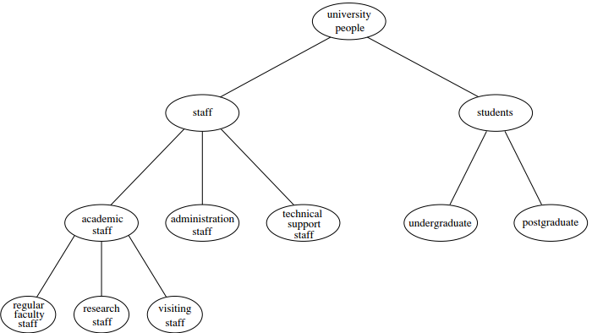
A toy Example

Slide 47
Components of ontologies
Terms denote important concepts (classes of objects) of the domain
Professors, staff, students, courses, etc.
Relationships between these terms
A class C is a subclass of class D if every object in C is also included in D
e.g., all professors are staff members

Slide 48
Components of ontologies (2)
Properties
X teaches Y
Value restrictions
Only faculty members can teach courses
Disjointness statements
Faculty and students are disjoint
Specification of logical relationships
Every department must include at least 10 faculty

Slide 49
Web Ontology Languages
RDF Schema
RDF is a data model for objects & relations
RDF Schema is a vocabulary description language for describing properties and classes of RDF resources
Notes:
RDF: JDK, what classes we can use, what methods we can invoke;
RDF Schema: Java language specification, how to define a new variable, how to implement a new class (by extending some basic abstract class);

Slide 50
Web Ontology Languages (2)
OWL: a richer ontology language
Relations between classes
Subclass, disjointness
Enumerated classes
Richer typing of properties
Characteristics of properties
e.g., symmetry

Slide 51
Logic & Inference
Logic is the discipline that studies the principles of reasoning
Formal languages for expressing knowledge
Inference: automatically deduce conclusions from the given knowledge

Slide 52
Example
Logic
Prof(x) → Faculty(x)
Faculty(x) → Staff(x)
Inference if given Prof(Michael)
Faculty(Michael), Staff(Michael)
Prof(x) → Staff(x)
Logic Programming
Notes:
Given rules (i.e., logic) and facts (e.g., Prof(Michael)), infer new knowledge. It is called logic programming.

Slide 53
Logic vs. Ontologies
Logic can uncover ontological knowledge that is implicitly given
Infer new/potential knowledge
Logic can uncover unexpected relationships and inconsistences
Validate the formulation of ontologies

Slide 54
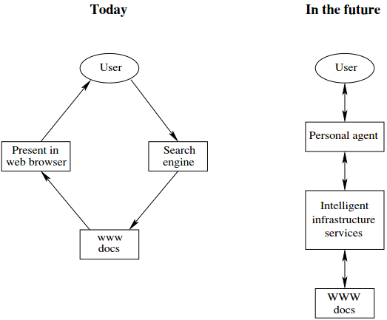
Software Agents
Notes:
Personalizations

Slide 55
Lecture Outline
A Motivation Example
Semantic Web Technologies
A Layered Approach

Slide 56
A Layered Approach
The development of the Semantic Web proceeds in steps
Each step building a layer on top of another
Principles
Downward compatibility
Upward partial understanding

Slide 57
The Layer Tower

Slide 58
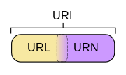
URIs/IRIs as foundation
URI = Uniform Resource Identifier
denote a unique web entity = {URL, URN}
URL = Uniform Resource Locator
http://www.librec.net/index.html
URN = Uniform Resource Name
ISBN by urn:issn:1535-3613
Geo by geo:37.786971,-122.399677
Mail by mailto:guogb@swc.neu.edu.cn
IRI = Internationalized Resource Identifier
URIs are limited to a subset of ASCII (English)
IRIs is just URIs but encoded in Unicode (Chinese, others)
Notes:
IRI: Internationalized Resource Identifiers, 国际化资源标识符
URI: a uniform resource identifier (URI) is a compact sequence of characters that identifies an abstract or physical resource.

Slide 59
URIs and QNames
URIs are often long and hard to read & write
Most serializations use an abbreviation mechanism
Define “prefixes”, “namespaces”
RDF/XML format: XML namespaces and entities
E.g., in Turtle serialization
@prefix dbp: <http://dbpedia.org/resource/> .
QName stands for "qualified name“
A QName like dbp:Oslo stands for http://dbpedia.org/resource/Oslo

Slide 60
Semantic Web Layers
XML layer
syntactic basis
RDF layer
RDF basic data model for facts
RDF Schema simple ontology language
Ontology layer
OWL

Slide 61
Semantic Web Layers (2)
Logic layer
Enhance ontology languages further
Declarative knowledge
Proof layer
Proof generation, exchange, validation
Trust layer
Digital signatures
Recommendations, rating agencies, etc.

Slide 62
Semantic Web as Web of Data
Human forms of knowledge are hard for machines to understand and generate
Machines should be able to use the Web to publish and retrieve information and knowledge
The Semantic Web is a collection of languages, ontologies, software tools, services and KBs that are designed to support machines
A Semantic Web is defined as a Web of Data (By W3C)

Slide 63
Semantic Web from Two Perspectives

Slide 64
Content
Part 1: Semantic Web
XML
RDF
OWL
Knowledge Graph
Notes:
语义网是万维网之父蒂姆·伯纳斯-李(Tim Berners-Lee)在1998年提出的概念，其核心是构建以数据为中心的网络，即Web of Data；这是相对于我们目前的万维网是Web of Pages而提出的。语义网的核心是让计算机能够理解文档中的数据,以及数据和数据之间的语义关联关系，从而使得机器可以更加智能化地处理这些信息。

Slide 65
XML (Extensible Markup Language)
<?xml version="1.0" encoding="utf-8"?>
<rss version="2.0">
<news>
<title>辽宁41名涉拉票贿选人员被依法惩处</title>
<author>www.qq.com</author>
<pubDate>2017-04-01</pubDate>
<description>新华社沈阳4月1日消息，3月28日至30日，沈阳、鞍山、抚顺15个基层法院分别对辽宁41名涉拉票贿选人员作出一审宣判。审理法院综合考虑各案被告人的犯罪事实、犯罪情节以及悔罪表现等因素，对营口港务集团有限公司原董事长高宝玉等41名被告人分别以破坏选举罪、贪污罪、受贿罪、行贿罪判处有期徒刑等刑罚。经审理查明，高宝玉</description>
</news>
</rss>
Notes:
RSS (Really Simply Syndication) 新闻订阅源即是一个xml文件。XML: 对数据进行无语义的格式化；
RSS Reader: Google Reader. 主要由门户网站生成新闻内容；内容更新慢；
微信、微博：即时更新，由普通用户创造；微信公众号/小程序：全力创作；
知识付费：用户花钱问问题，牛人来回答。该模式在炒股上表现极为突出，以为花钱买消息，其实买的是认同。当然，现在的知识付费模式很多：打赏，付费阅读、付费问答等；

Slide 66
RDF (Resource Description Framework)
<?xml version="1.0"?>
<rdf:RDF
xmlns:rdf="http://www.w3.org/1999/02/22-rdf-syntax-ns#"
xmlns:news="http://www.news.fake/news#">
<rdf:Description
rdf:about="http://news.qq.com/a/20170401/036490.htm">
<news:author>www.qq.com</news:author>
<news:category>国内新闻</news:category >
<news:subcategory>政治</news:subcategory >
<news:date>2017-04-01 17:55:57</news:date>
<news:description>新华社沈阳4月1日消息，3月28日至30日，沈阳、鞍山、抚顺15个基层法院分别对辽宁41名涉拉票贿选人员作出一审宣判。
</news:description>
</rdf:Description>
</rdf:RDF>
Notes:
RDF: 对格式化的数据添加语义信息；
目前知识图谱普遍采用了语义网框架中RDF(Resource Description Framework,资源模式框架)模型来表示数据。

Slide 67
OWL (Web Ontology Language)
<rdf:Property rdf:ID=“subCategory">
<rdfs:label>node</rdfs:label>
<rdfs:subPropertyOf
rdf:resource="category"/>
</rdf:Property>
Notes:
OWL: 对语义进行精细定义，如一个属性与其它属性之间的父子关系等。

Slide 68
Knowledge Graph
The Knowledge Graph is a knowledge base used by Google to enhance its search engine's search results with semantic-search information gathered from a wide variety of sources.
Knowledge Graph display was added to Google's search engine in 2012, starting in the United States, having been announced on May 16, 2012.
-- Wikipedia

Slide 69
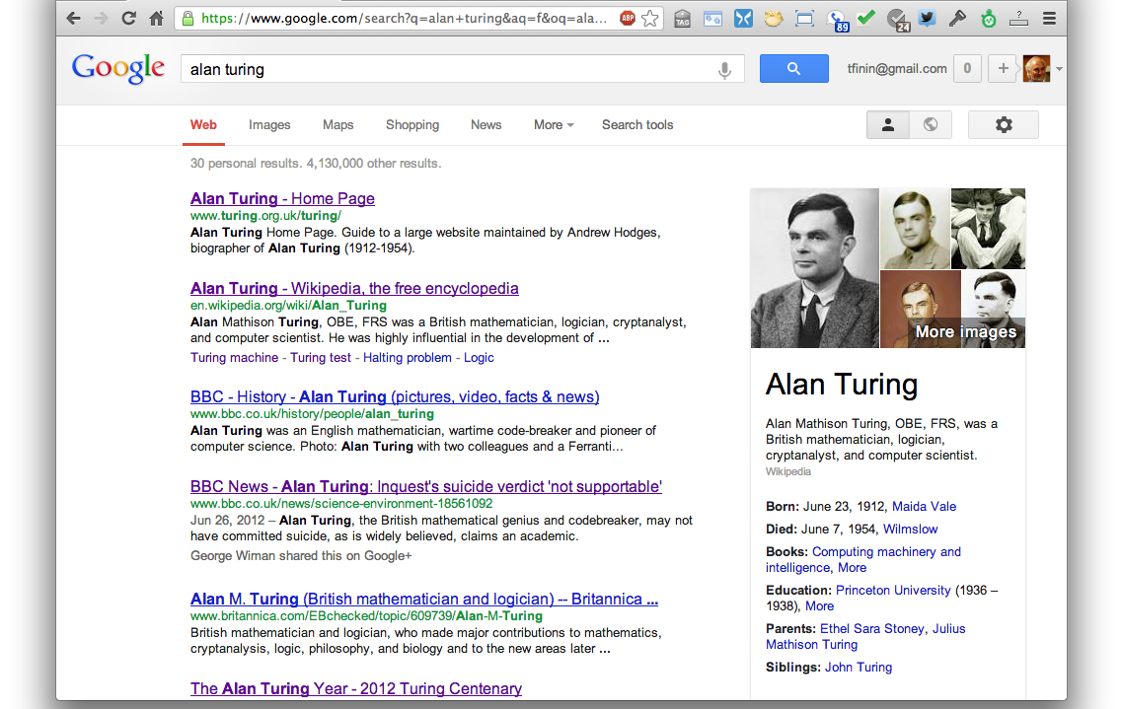
Google Knowledge Graph
Google’s Slogan: “things, not strings”

Slide 70
Facebook Graph Search
Notes:
Facebook也定义了一种类似的标签语言，名叫Open Graph Protocol（OGP）。Facebook利用OGP协议定义了社交网络中上的知识图谱，即Facebook Social Graph，用于连接社交网络的用户，用户分享的照片，电影，评论，甚至包括通过Facebook定义的Graph API所链接的第三方的关于社交用户知识图谱数据。在所构建的Social Graph基础上，Facebook推出了Graph Search（图搜索）功能。将用户的自然语言问题，转化为面向Social Graph上的图搜索问题，从而回答用户的问题。Facebook将用户的输入的自然语言转化为面向Social Graph的结构化查询操作。从图8中可以看出，原始查询语句在经过自然语言接口模块处理后，对应的规范化自然语言查询语句和结构化查询语句分别为：“my friends who live in [id:12345]”和“intersect(friends(me), residents(12345))”[31]。其中，“12345”代表“Canada”在社交图谱上对应的Facebook ID。对应的结构化查询语句会交给Facebook内部设计的面向社交图谱的索引和搜索系统Unicorn[2]，最后查询得到答案。

Slide 71
Acemap Knowledge Graph
http://acemap.sjtu.edu.cn/app/AceKG/

Slide 72
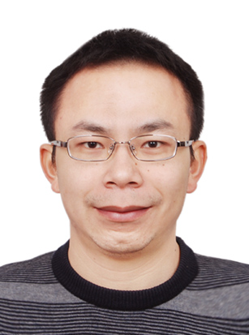
Knowledge Graph
源图来自于：https://mp.weixin.qq.com/s/8tOmTvHDnAa4ZoaemZheYQ
“总的来说，知识图谱是一项交叉研究领域；计算机的不同学科都从不同的角度对知识图谱这个领域进行了研究工作。”
邹磊
北京大学副教授
Notes:
发表于 2017-4-6；
优青基金的获得者；
http://www.icst.pku.edu.cn/intro/leizou/cn/index.html

